Slide 1
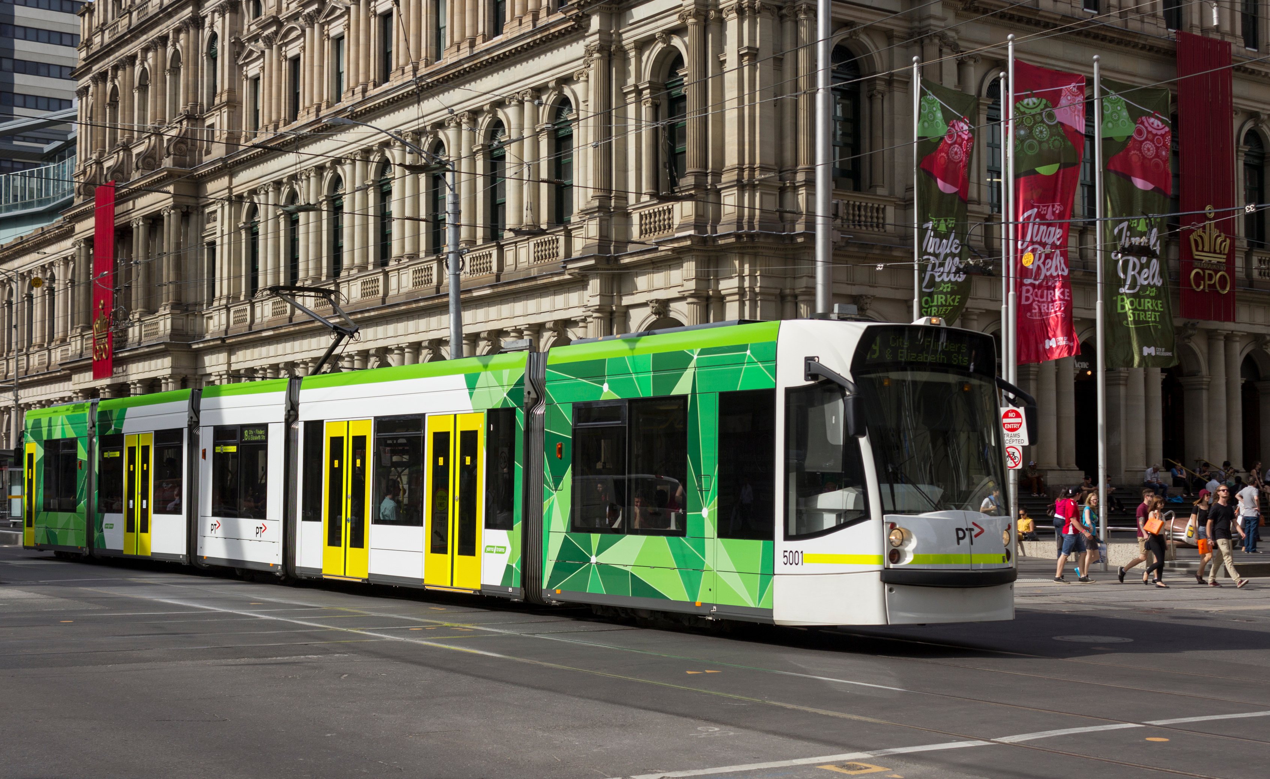
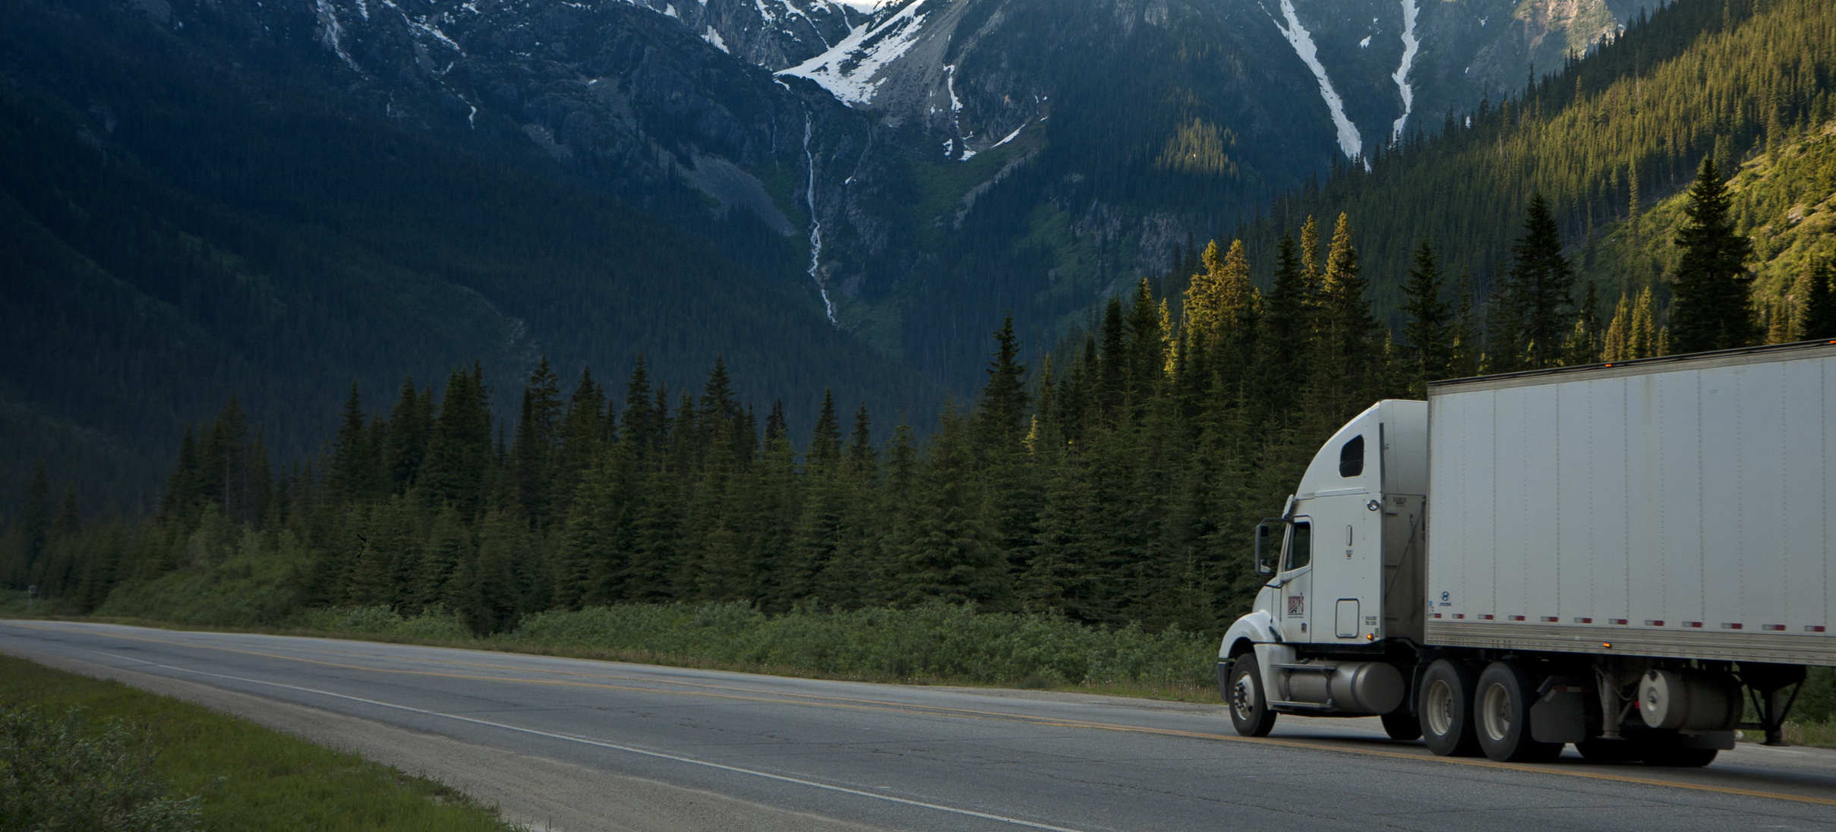
PUBLIC TRANSPORT HUB
PTV - RE-IMAGINED
The New Normal of Public Transport
Staying Ahead for a Sustainable Future &
Adapting to New Normal
Notes:
Good day.
We would like to take you through our journey to re-imagine public transport victoria.

Slide 2
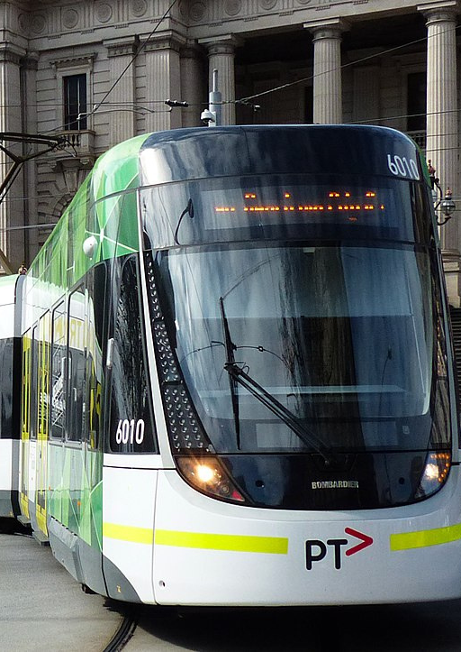
Problem
A sustainable & optimized way of public transport co-existing with personal transport, is the need of the hour
to reduce carbon emissions
to make travel safer during pandemic
to determine & encourage more people to use public transport / walk (where ever possible)
Notes:
Our aim is to reduce carbon footprint, and
make travel experience better and safer.

Slide 3
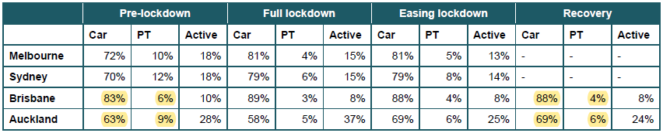
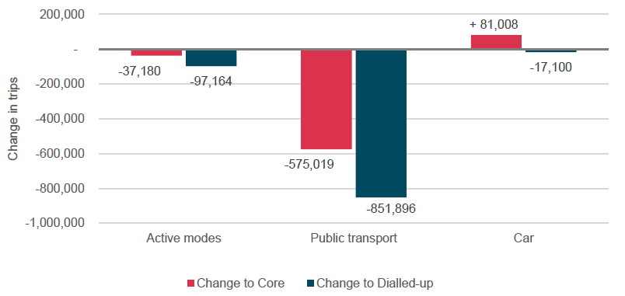
Why?
Why do we need such a solution? Were we not traveling before?
Are we travelling the same?
COVID-19 has altered our way of life dramatically.
Our social interactions, our professional dynamics, and our digital relationships are all transformed.
The Public Transport sector has certainly not been immune to that transition.
Change of transportation preference (Covid) from baseline (pre-Covid)
Implied mode share across cities and time period
Notes:
In new normal more people are using private transport,
which means more emissions and under utilization of public infrastructure.
this is only expected to grow during recovery as seen in other cities like Brisbane

Slide 4
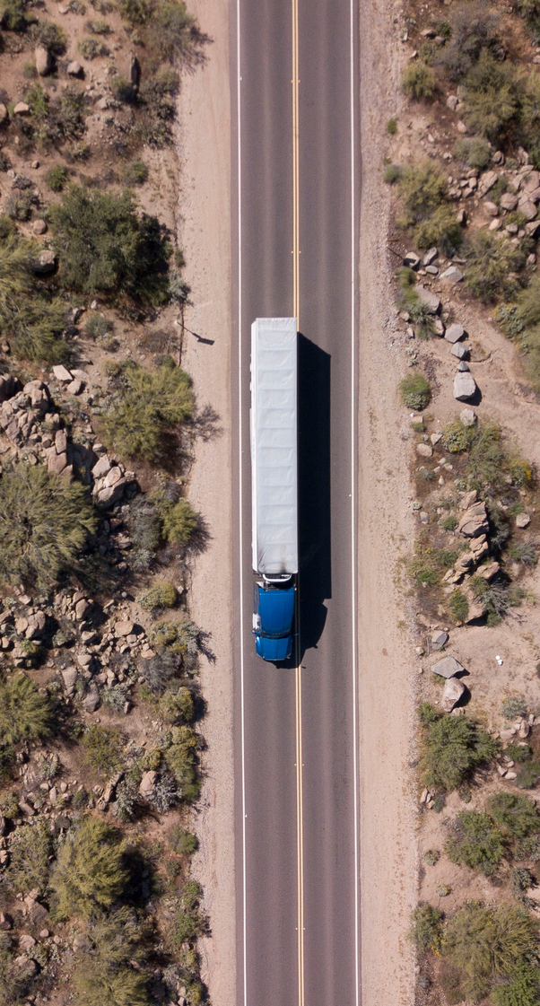
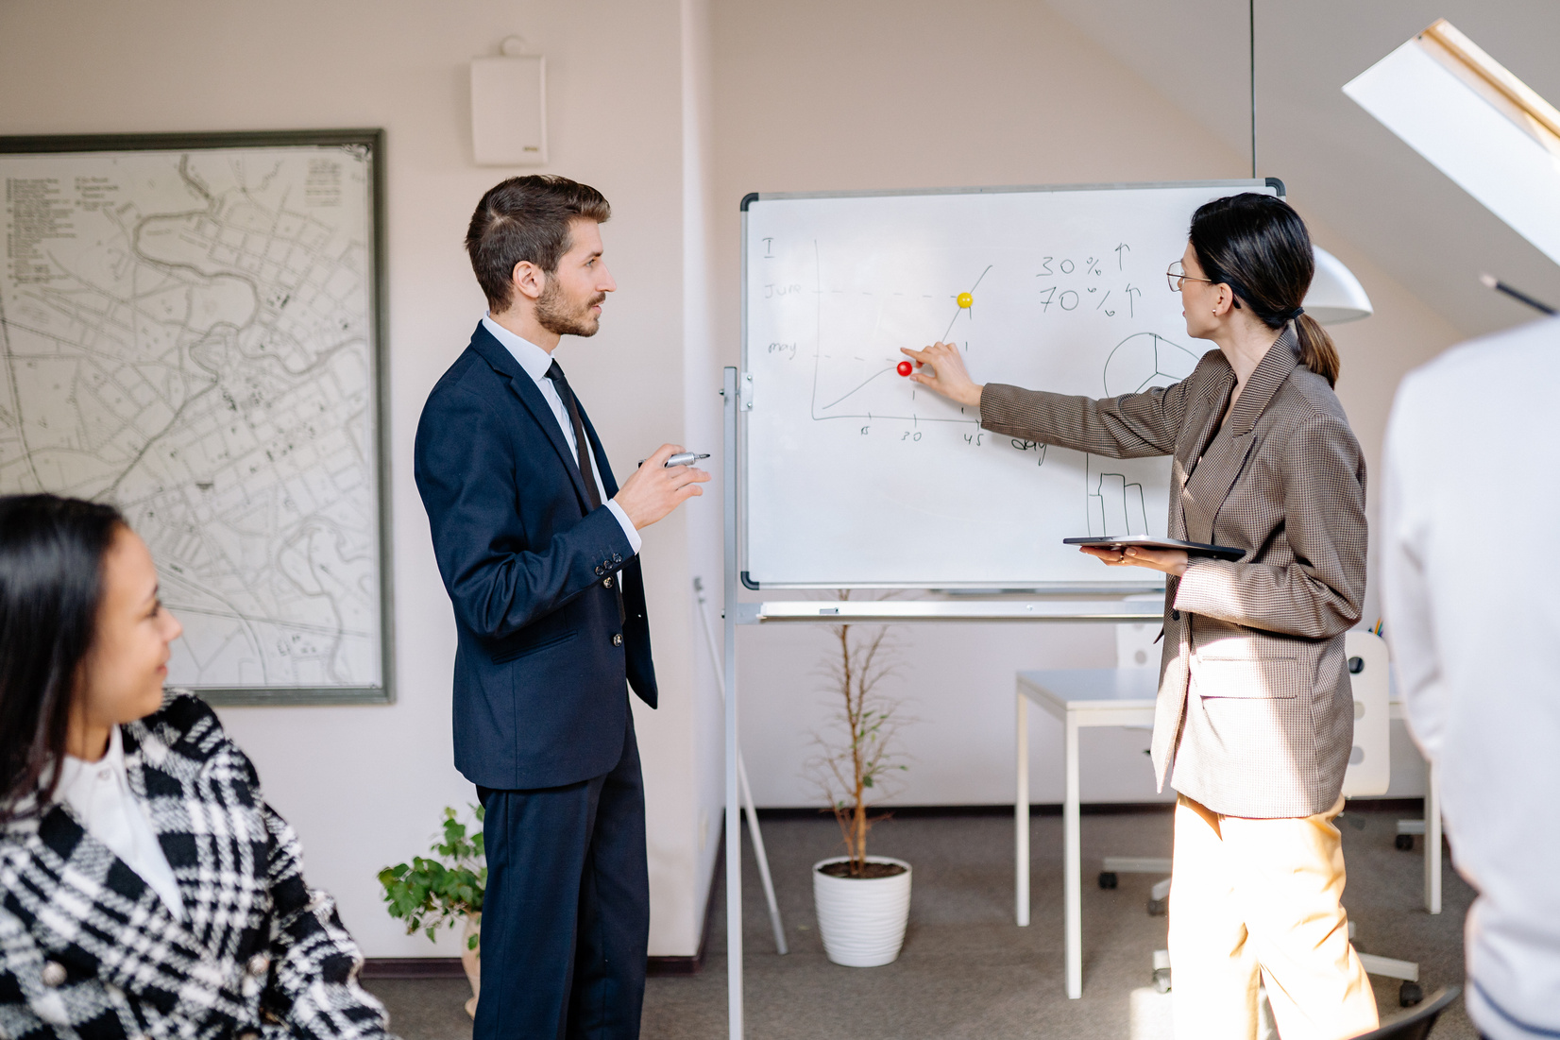
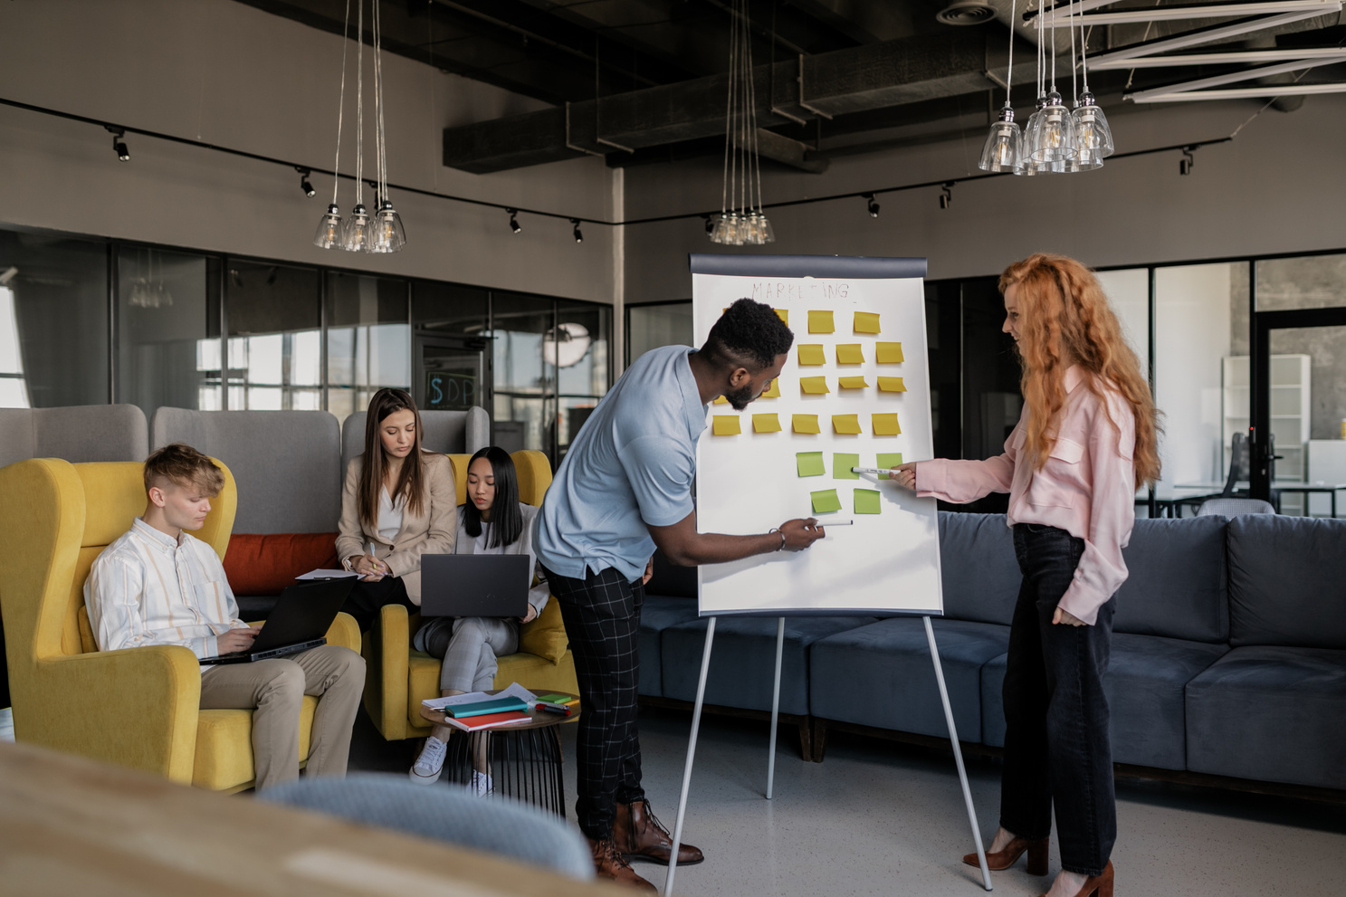
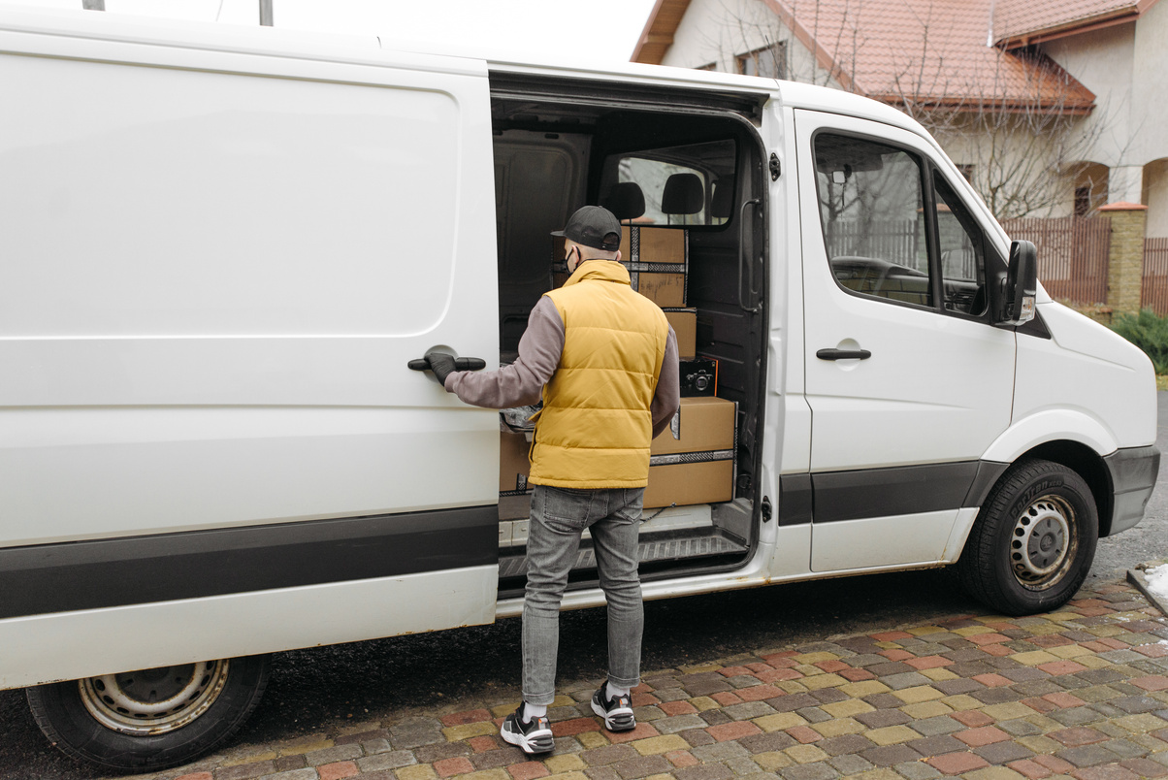
Supporting people getting
back to work and school
Initiatives / Awareness
Provide a better experience through park and ride.
Provide data on traffic congestions and parking availability to better map the journey and reduce travel time.
Encourage environment-friendly options through a reward system.
Notes:
By utilising the public dataset we can bring intelligence through aspects such as smart and hybrid park and ride, managing crowd and improving safety and aligning to a reward system.

Slide 5
Solution - PTV - Re-Imagined
01
02
03
INTEGRATE TRAVEL - PARKING WITH PTV
PUBLIC SAFETY : AVOID HIGHLY ACTIVE AREAS
GREEN REWARDS
Give green points to people for reducing transport emissions. Which can be later redeemed for vouchers.
Help public navigate to parking then to the destination
Help pedestrians navigate from A to B by avoiding active areas which reduces transmission.
Notes:
Our PTV-ReImagined Solution includes integrating open data such as parking occupancy and pedestrian count with PTV.
This will help in safer and low carbon travel, all of which can be encouraged by reward system.

Slide 6


Parking
Integration with parking data can reduce CO2 emissions (182grm/km),
Saves time, reduces congession
Avoid wasting time to find parking
Generate revenue for the governement
Customers want to get quick parking
Notes:
Finding Parking has always been a problem in metropolitan areas.

Slide 7
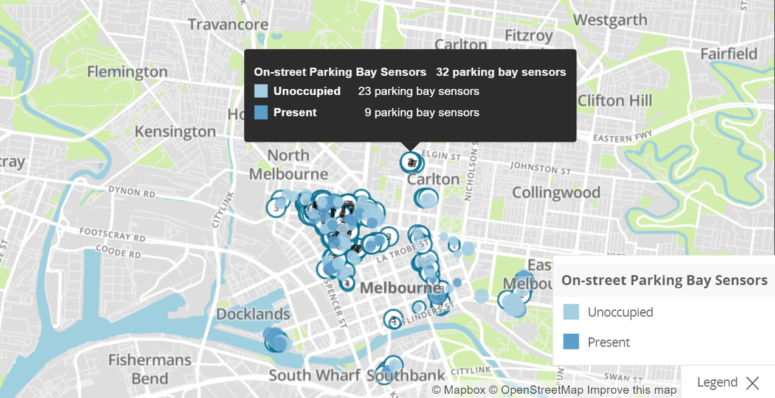
Parking Data
SHOWS NUMBER OF AVAILABLE SLOTS (BLUE MEANS AVALAIBLE)
Can direct public towards less occupied zones and increase infrastructure usability and better experience to the public
Notes:
Use open data to integrate with PTV to allow hybrid travel options along with Green reward points

Slide 8
Public Transport
Rewards based better utilisation of infrastructure
Increase in revenue
Less private transport on roads
Reduced carbon emissions
Notes:
Which can also be integrated with public transport for Park and ride.

Slide 9
Infrastructure
Better utilisation of infrastructure
Graphs and charts will provide better view to plan infrastructure strategies.
Avoid high stress in particular areas
More revenue generation
Notes:
which will help in optimised utilisation of government infrastructure

Slide 10
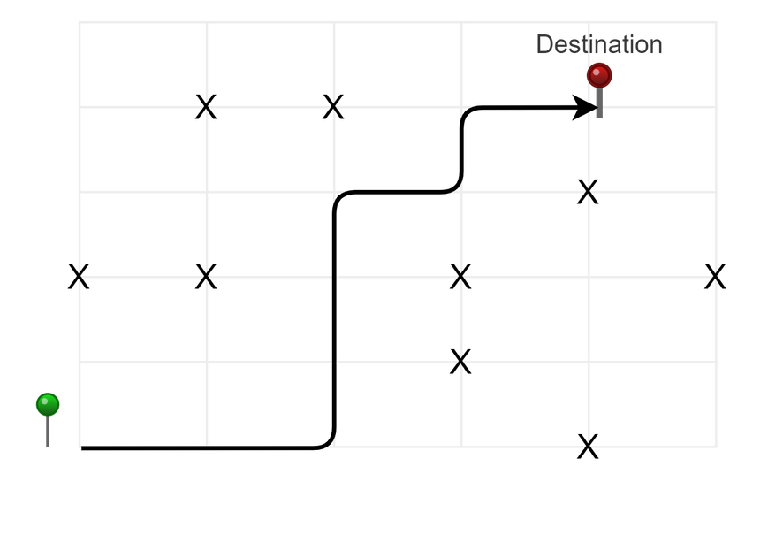
Active travelling
Reduce transmission rates
customers want more real-time updates
Charts and graphs help people process and understand the impact of services
Visualize complicated and dense information with charts and graphs.
Notes:
We can also make travel safer for active users by integrating pedestrian count system used by government and help them avoid highly active areas which will also help in reducing community transmission of COVID among active users.

Slide 11
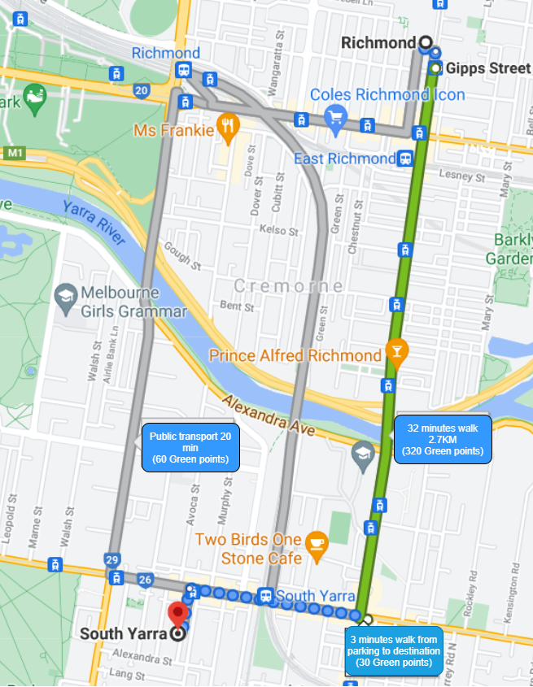
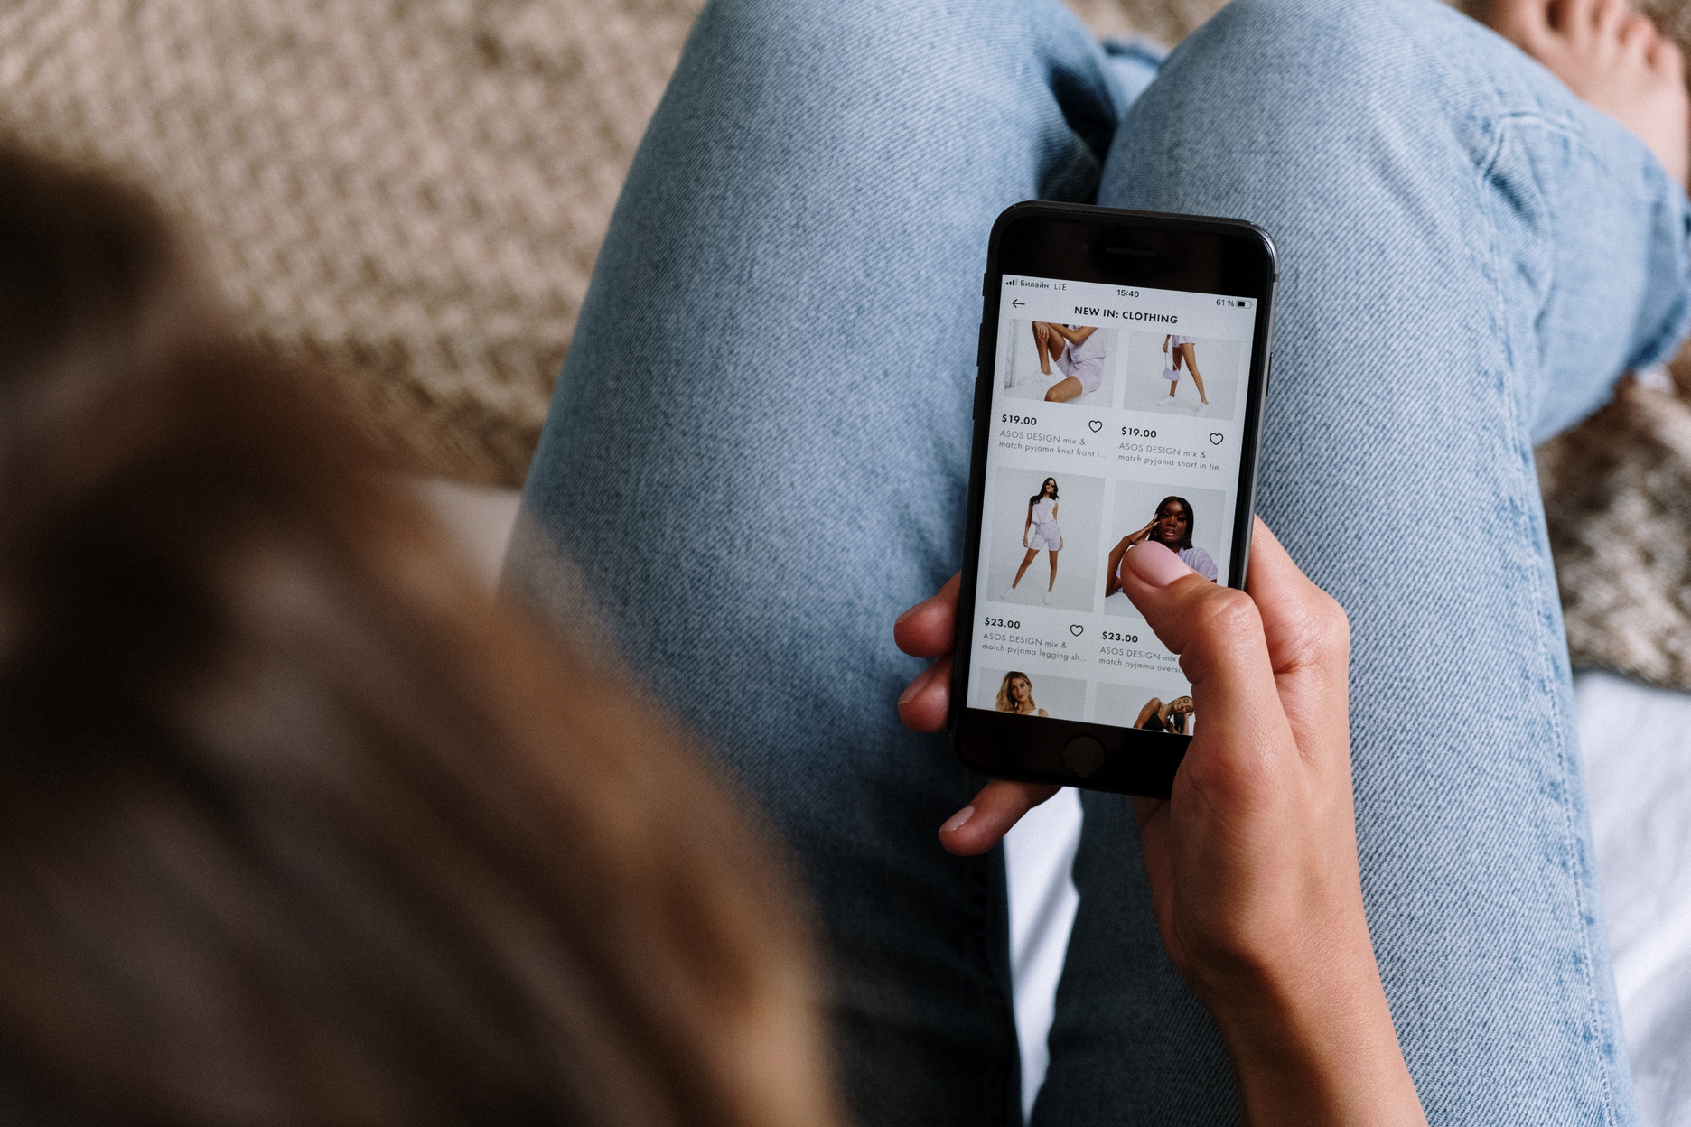
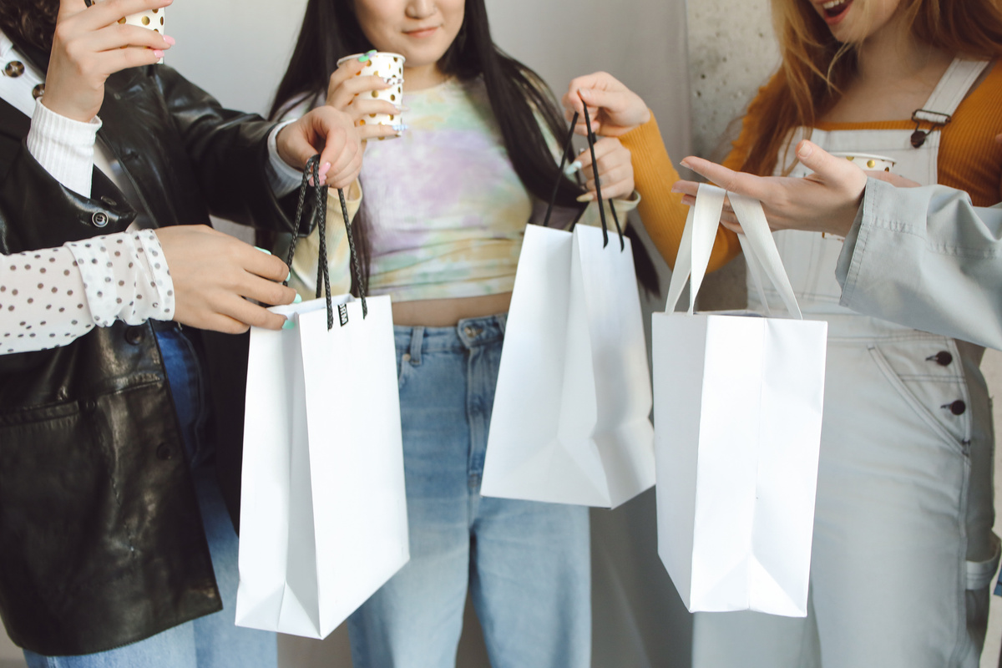

Rewards Sytem
Get rewarded for economic travel
Notes:
This all can be encouraged by reward system.

Slide 12
Reduction in carbon emissions
12,348
METRIC TONES
11,730
METRIC TONES
Pre-covid emissions
12,348 Metric tones
Predicted emissions
11,730 Metric tones
5%↓ (Pre-Covid)
11,368
METRIC TONES
Covid-emissions
11,368 Metric tones
Notes:
Our estimates shows 5% reduction in carbon emission which stands at approx 617.4 Metric tonne less carbon in Victoria.

Slide 13
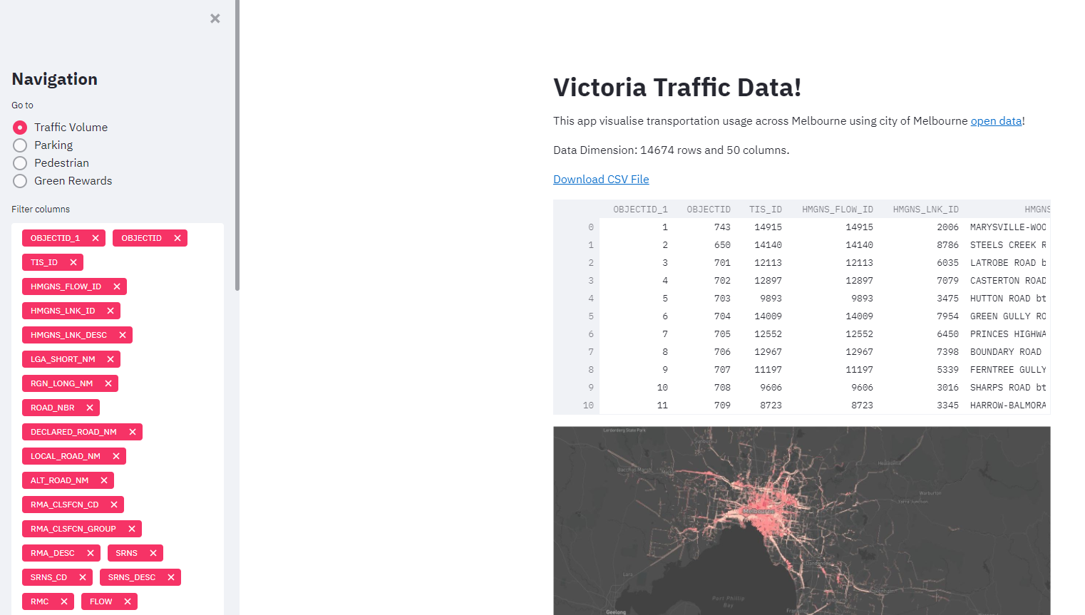
Demo
Notes:
Lets have a look at our application

Slide 14
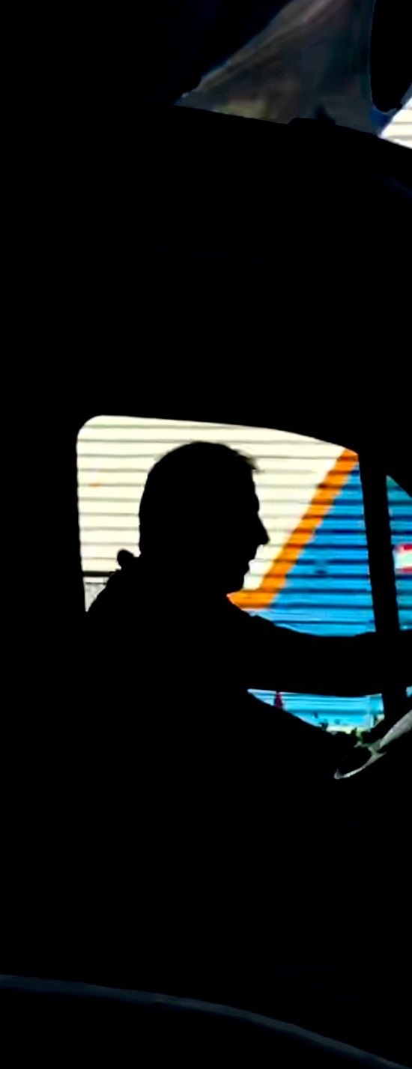
OUR UNIQUE VALUE PROPOSITION
We're in to solve multiple ground level challenges
FEATURES
BENEFITS
Track best time for logistic movement
Avoid high pedestrian zones
Quick parking
Transport infromation
Carbon emission information
Smooth and seamless experience
Real-time updates
Fast travel
Reduced emissions
Notes:
The integrated approach shall provide a real-time, omni channel experience for the transport users encouraging safer journey options and optimised usage of resources.

Slide 15
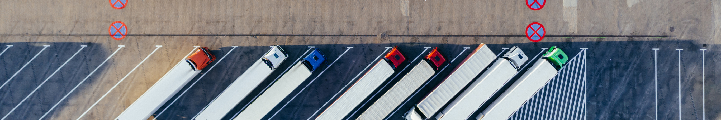
Opportunity for the broader transport system and associated services
logistics and Trucking
Better travel (in terms of time and emissions) for the Logistics and Trucking industry.
Provide parking availability info. for better time management and generate revenue.
Provide emission and cost information to support economical ways to travel.
Notes:
Solution can be extended for broader transportat system such as logistic and trucking industry

Slide 16
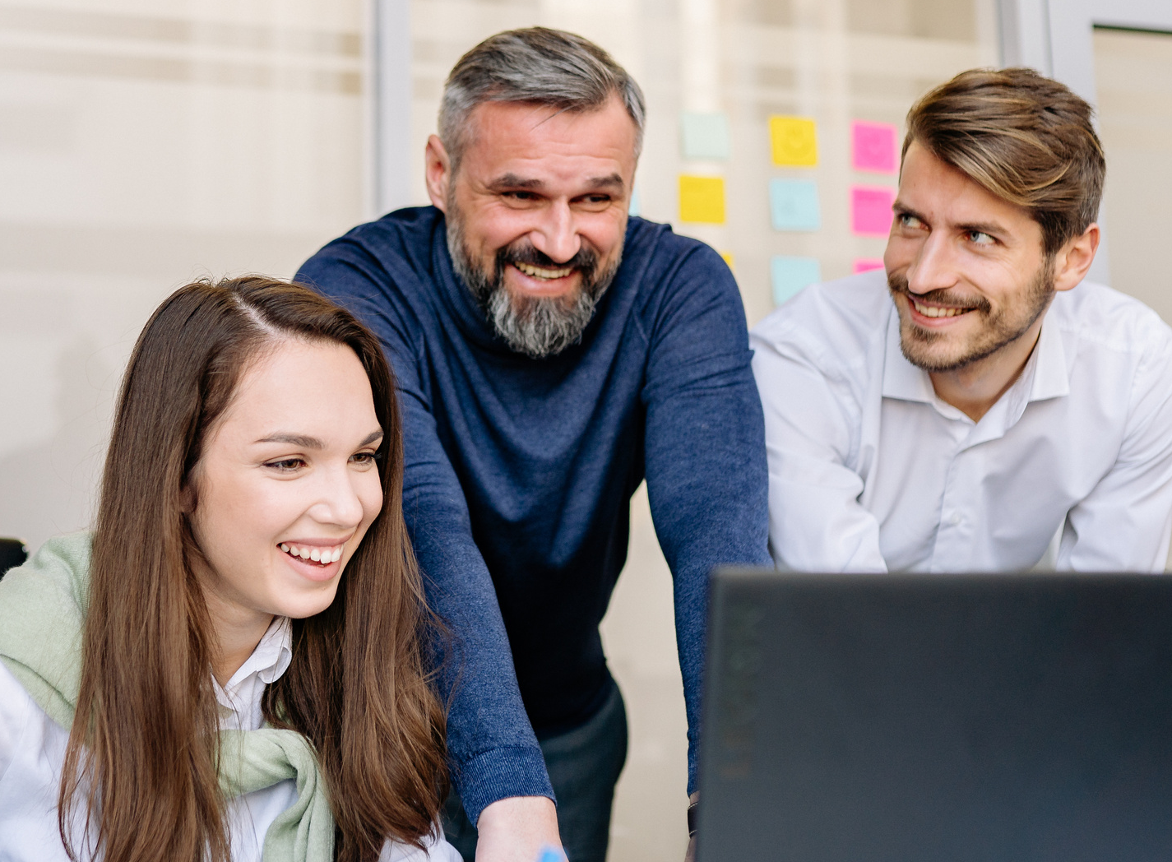
01
INTEGRATED TRAVEL
By encouraging people to use public transport integrating with multiple options, optimized way to find parking
HIGHLIGHTS
02
PUBLIC SAFETY
Providing dynamic assistance to find less dense and safe travel options.
03
GREEN REWARDS
Gamification to encourage carbon emission reduction, avoiding highly dense transport options or areas
04
ENHANCED INCLUSIVE EXPERIENCE
Increasing public awareness and interaction with the application which can be further used to improve and optimise
Staying Ahead for a Sustainable Future &
Adapting to New Normal
Notes:
We aim to stay ahead for sustainable future. adapting to the new normal by providing integrated travel , public safety, rewarding and enabling enhanced inclusive experience.

Slide 17

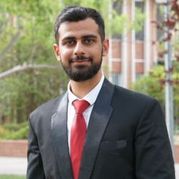
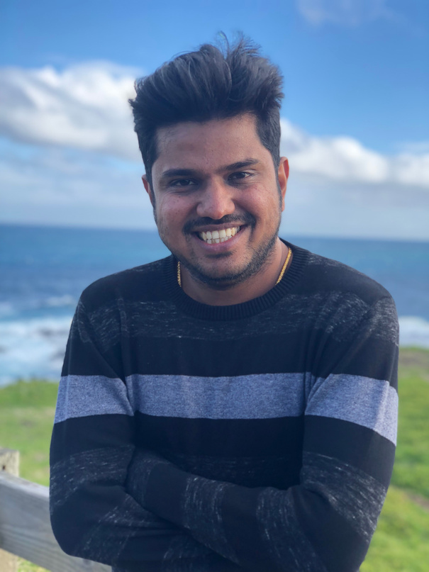
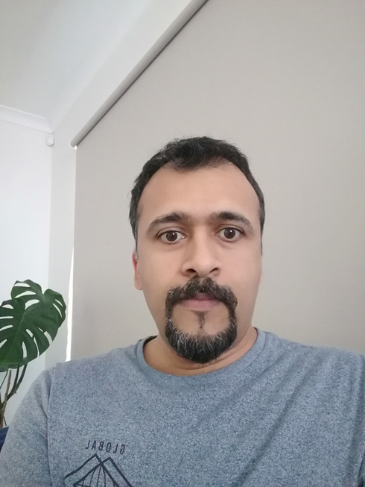
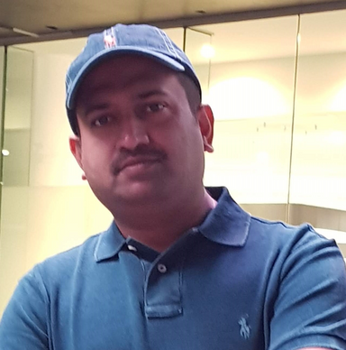
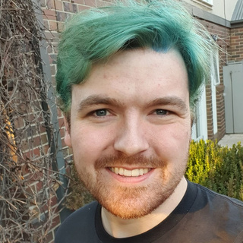
Thank you!
Have a great day ahead.
Introduction
The Team
Vivek, Thiru, Ben, Antony & Praveen
The goal is to encourage the use of public transport, reduce travel time, reduce congestion, and an overall better experience for the public and the government.
Vivek
Thiru
Antony
Praveen
Ben
Notes:
Thank You.

